Slide 1

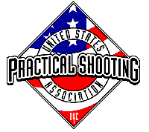
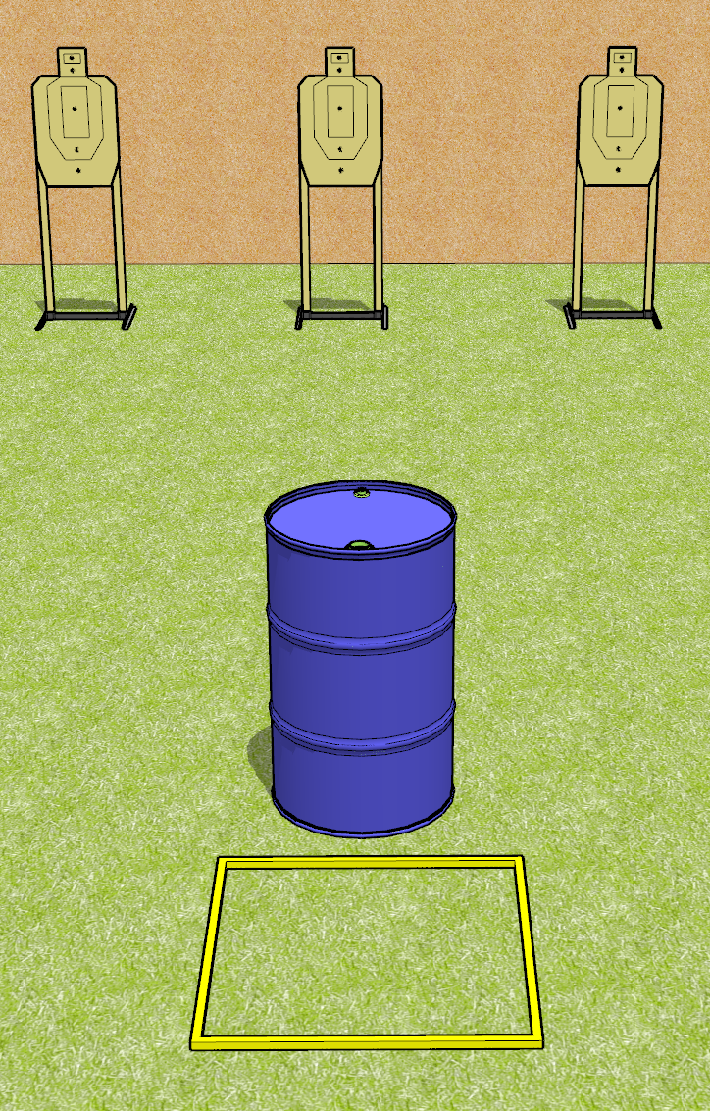
 | Dothan Gun Club – USPSA Match Triple Bill Drill Course Designer : Dan Mitchell
Round Count 18 rounds 3 USPSA
Equipment List Shooting box

Slide 2
Triple Bill Drill
Written Stage Briefing
Triple Bill Drill is an 18 round, 90 point, Comstock course of fire. There are 3 USPSA targets. The best 6 hits on paper will score. The start signal is audible.
Handgun start position is in shooting box, wrists below belt. Handgun is loaded and holstered.
PCC start position is in shooting box, stock on belt. Carbine is loaded with safety on.
On start signal, engage a target with 6 rounds, reload, engage another target with 6 rounds, reload, and engage the last target with 6 rounds. Magazines may come from barrel.

